Slide 1
What does it mean to be a Titan?

Slide 2
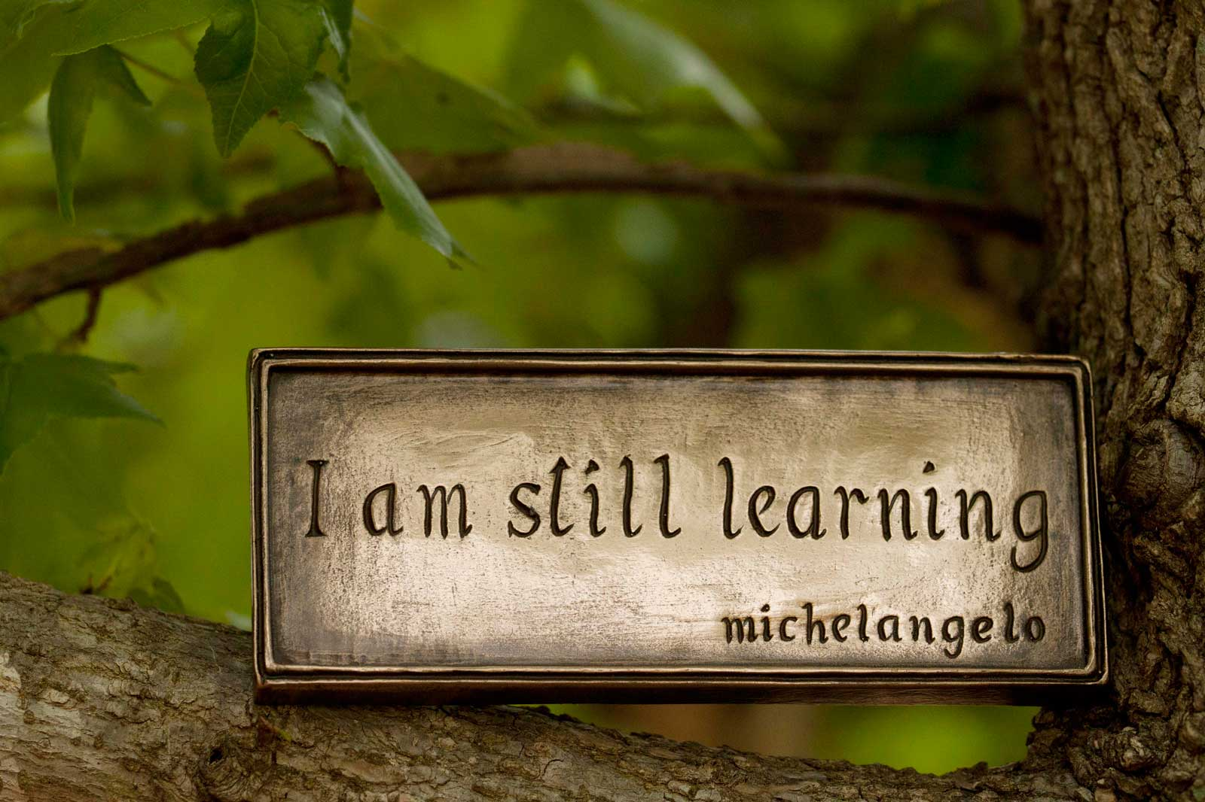
Mission Statement
The Classical Academy exists to assist parents in their mission to develop exemplary citizens, equipped with analytical thinking skills, virtuous character, and a passion for learning, all built upon a solid foundation of knowledge.
Notes:
QUESTIONS:
How would these traits make someone an “exemplary citizen”?
Why would becoming an exemplary citizen be an important goal?
What kind of “citizen” are you? How do you contribute to the larger group? How does the group benefit from each and every citizen?

Slide 3
Titan’s Creed
Titans celebrate virtue in scholarship, relationships, and citizenship.
Notes:
QUESTIONS:
What stands out to you in this statement?
What does virtue mean?
What are ways in which we can practice scholarship, relationships, and citizenship in school?
What are ways in which we can practice scholarship, relationships, and citizenship outside of school?
How do you personally show virtue in these areas already? Are there areas that you could work on? What would that look like?

